Slide 1
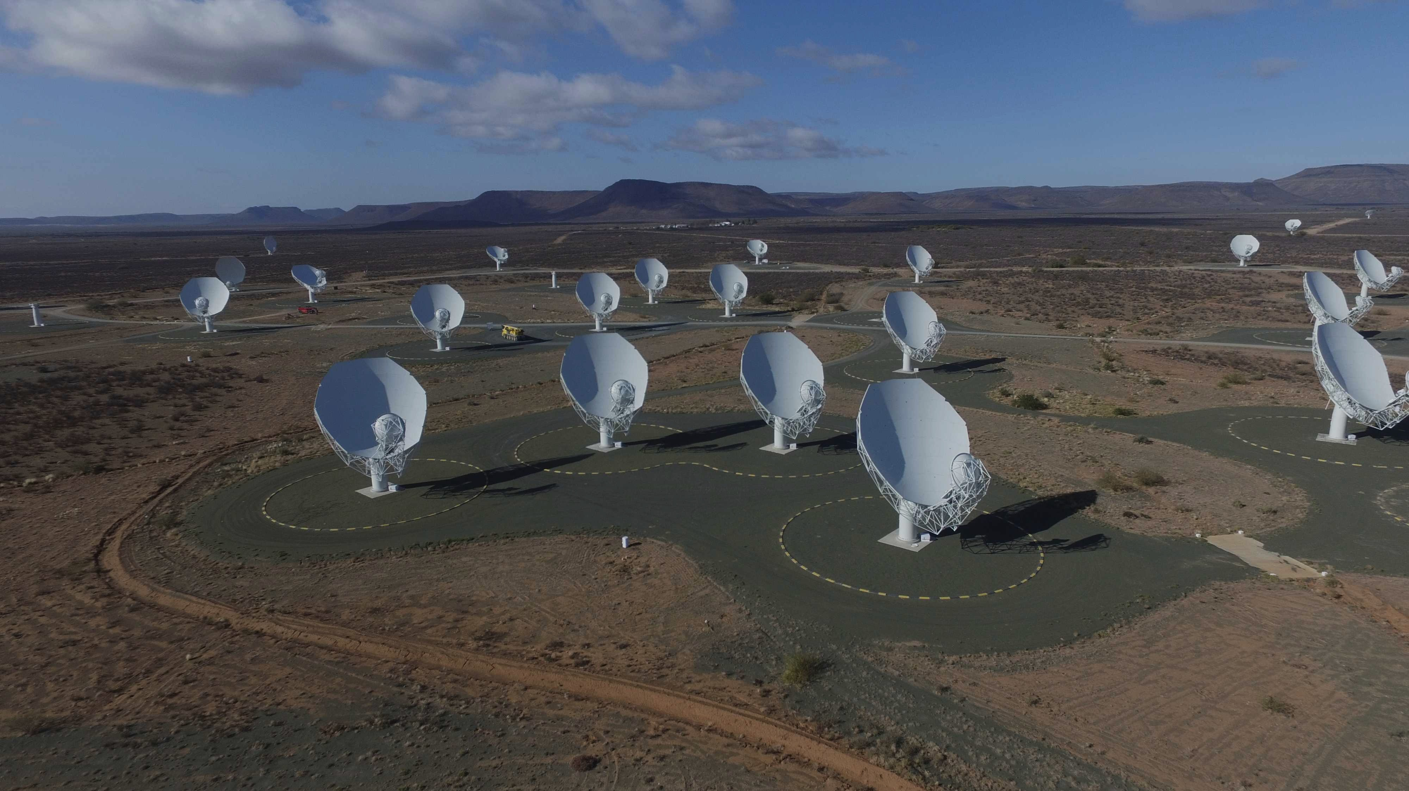

Project Proposal
Component separation for HI 21 cm and Synchrotron emission using MeerKAT single – dish data
Name: Topollo Naketsana
Supervisors: Prof Mario Santos & Dr Karin Fornazier

Slide 2
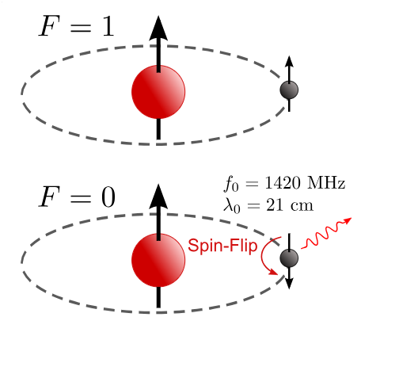
1. Introduction and scientific motivation
HI & intensity Mapping
We want to understand the large-scale distribution of matter in the universe
Powerful tracer for that – HI 21 cm
HI 21 cm due to the spin-flip transition
of an electron
This signal help us to map the distribution
of matter

Slide 3
1. Introduction and scientific motivation
Why is this important?
BAO – Which are the fluctuations in the density of the baryonic matter
Dark matter - HI 21 cm indirectly maps the underlying dark matter distribution
Dark energy and expansion – Mapping the BAO, we can constrain the dark energy and test cosmological models
$δT_{b}\left(ν\right) ≈27x_{HI}\left(1+δ_{b}\right)\left(1 − \frac{T_{γ}}{T_{s}}\right){\left(\frac{1+z}{10}\right)}^{1/2}$ $\left[mK\right]$

Slide 4
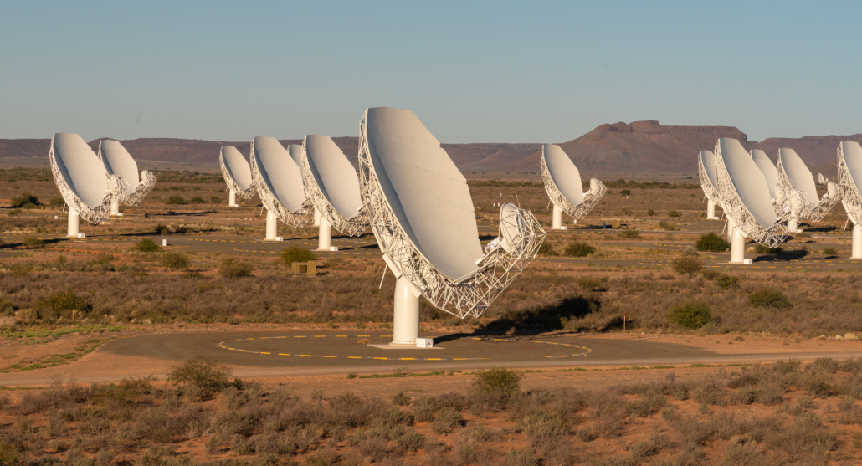
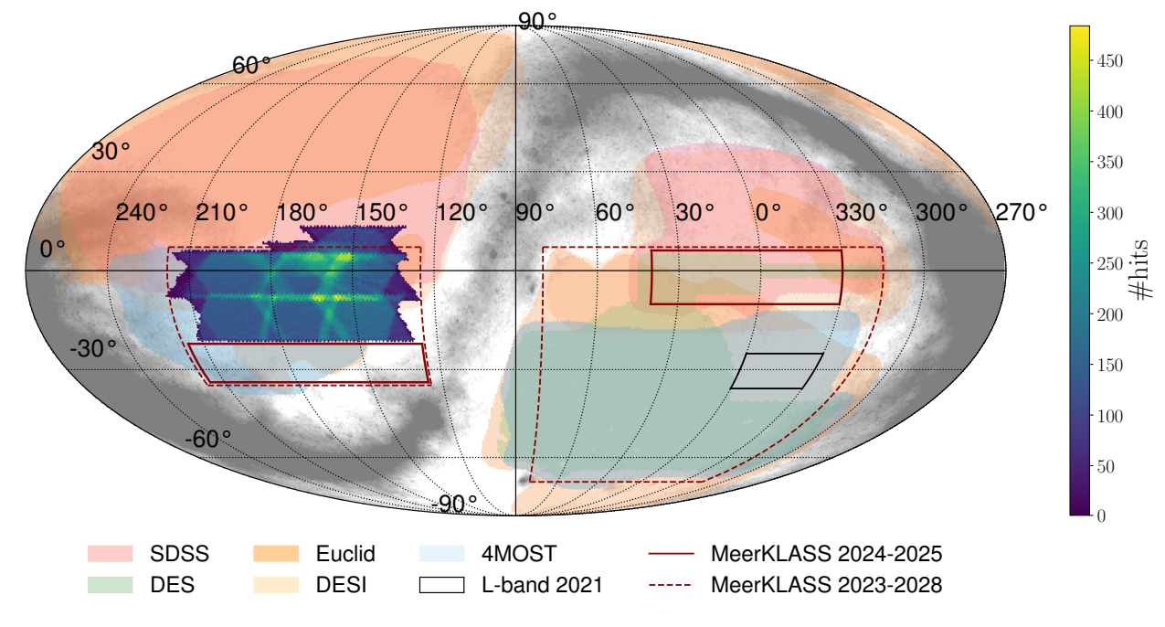
Data and scientific tools
MeerKAT
MeerkAT
64 dish radio telescope
But single – dish data in this project
MeerKLASS
Radio survey project
Focus: in the redshift z ~ 0.4 – 1.45
Our work:
1. Simulation pipeline
2. Data Pipeline (MeerKLASS)

Slide 5
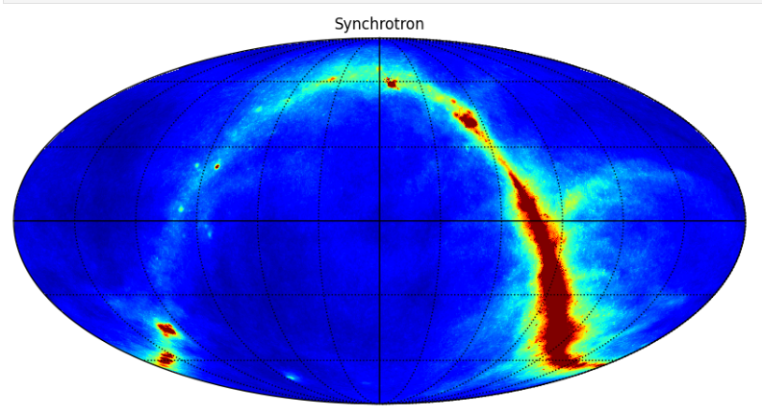
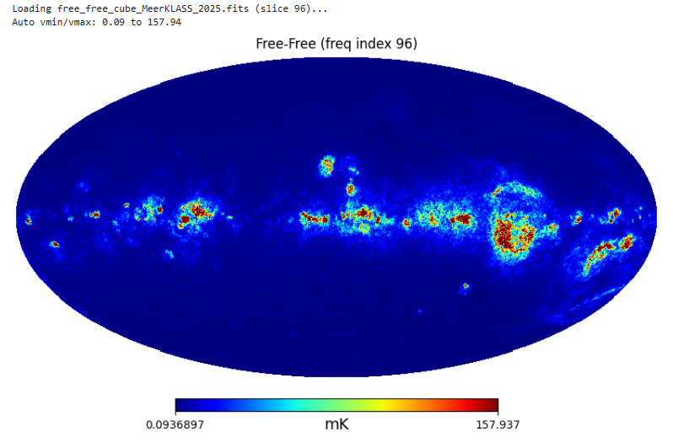
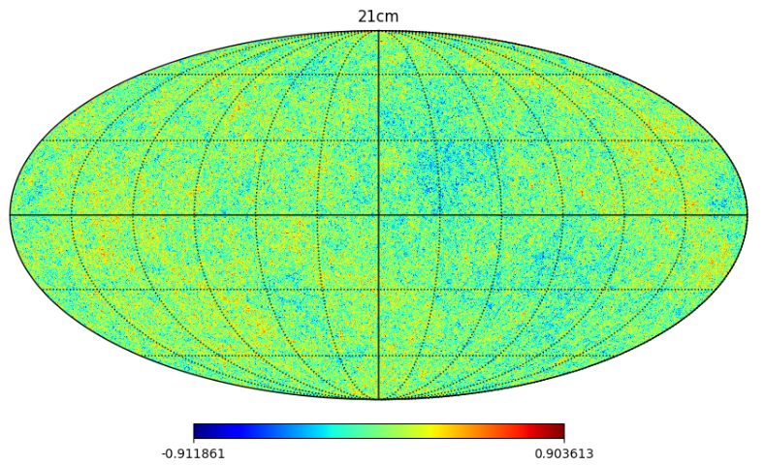
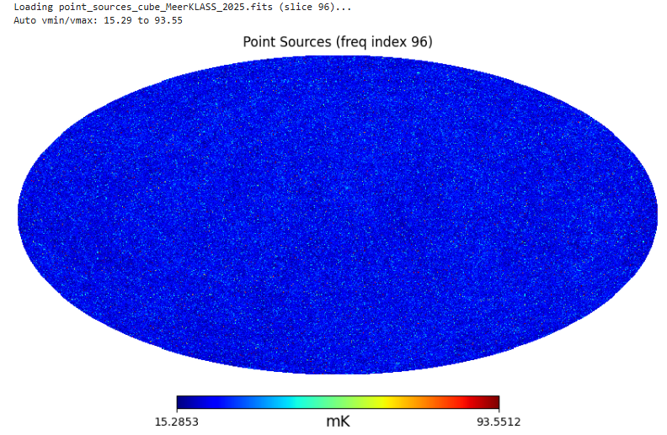
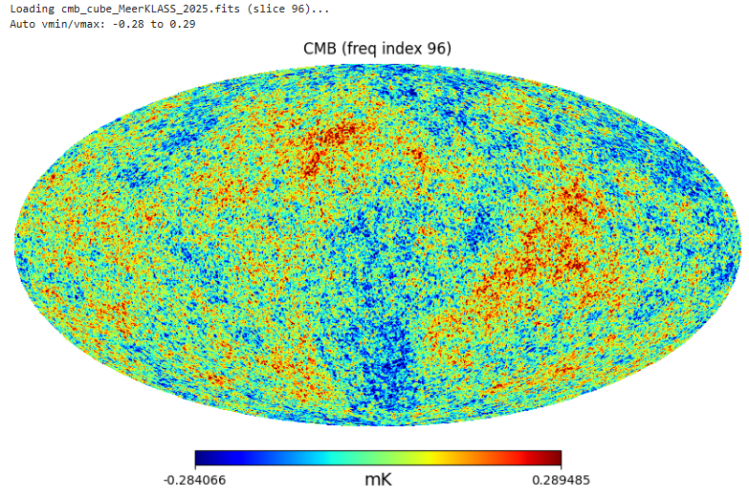
Foregrounds – simulated maps
Components (Foregrounds)
Synchrotron emission
Free – Free emission
Extragalactic sources
CMB
Synch is the dominant contaminant
Contaminates the HI signal
Challenge: All emissions are
orders of mag brighter than HI signal
Goal – Component Separation

Slide 6
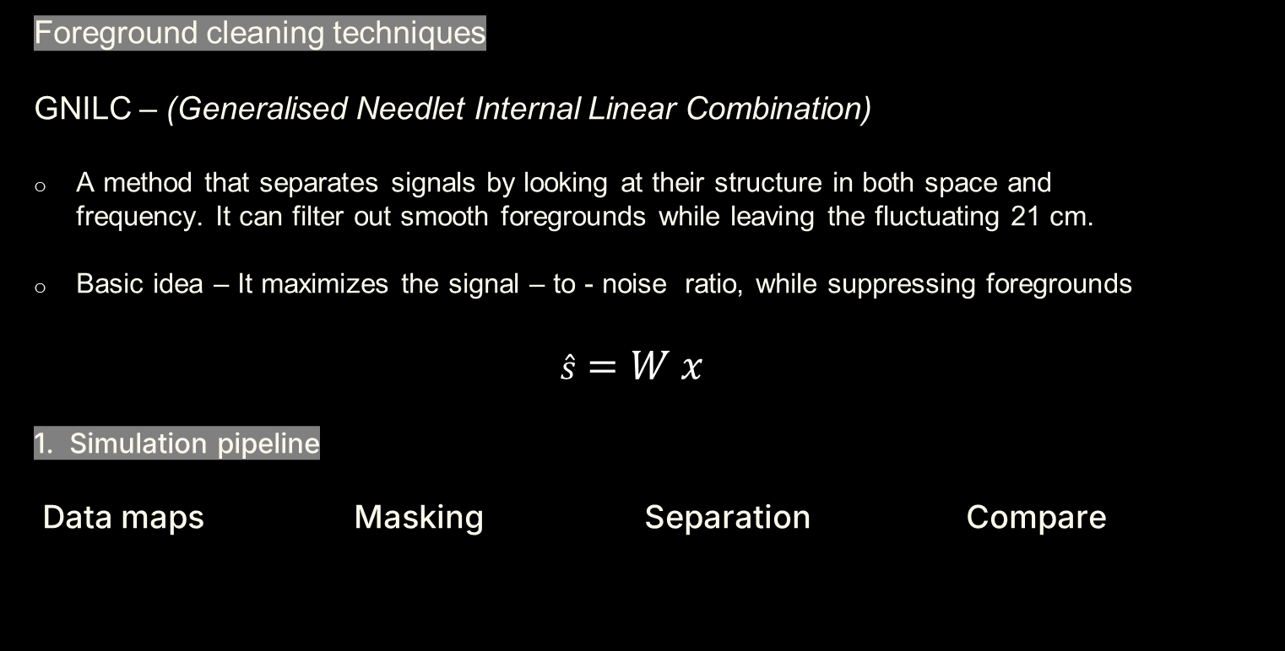
Data and scientific tools
Foreground cleaning techniques
GNILC – (Generalised Needlet Internal Linear Combination)
A method that separates signals by looking at their structure in both space and frequency. It can filter out smooth foregrounds while leaving the fluctuating 21 cm.
Basic idea – It maximizes the signal – to - noise ratio, while suppressing foregrounds
$$\hat{s}=W x$$
1. Simulation pipeline
Data maps Masking Separation Compare
Binary Mask
GNILC
Signal RECOVER

Slide 7
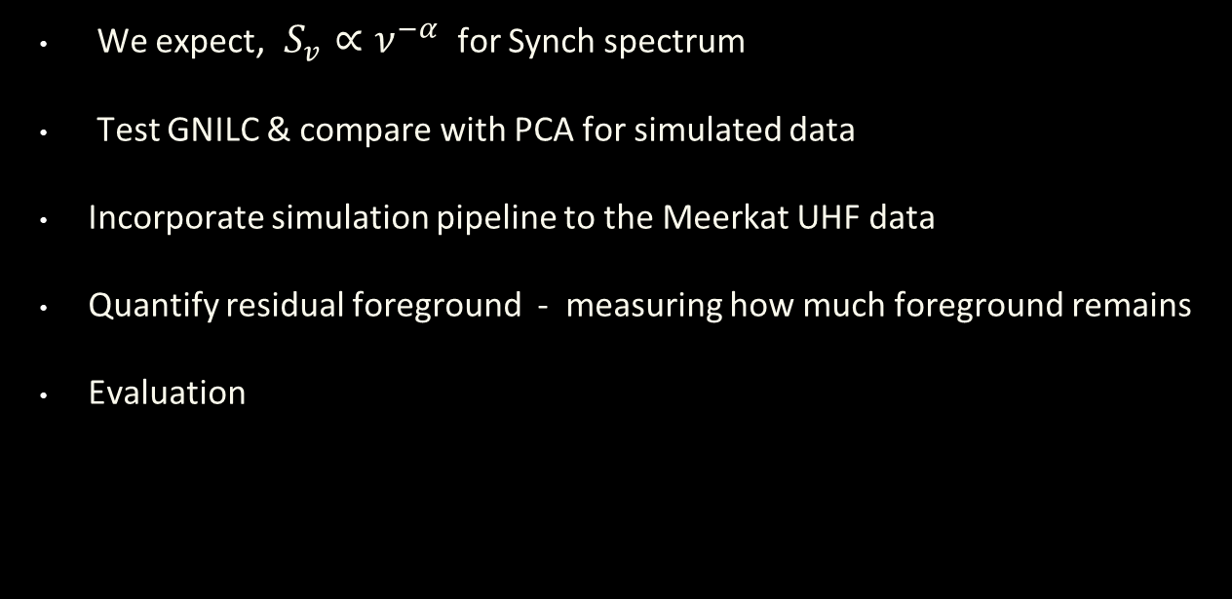
Expected results & Next Steps
We expect, $S_{v}∝ν^{−α}$ for Synch spectrum
Test GNILC & compare with PCA for simulated data
Incorporate simulation pipeline to the Meerkat UHF data
Quantify residual foreground - measuring how much foreground remains
Evaluation

Slide 8
References
Olivari, L. C. (2018). Intensity Mapping: a New Approach to Probe the Large-Scale Structure of the Universe
Olivari, L. C.(2018). GNILC: Generalized Needlet Internal Linear Combination
Santos, M.G., Cluver, M., Hilton, M., Jarvis, M., Jozsa, G.I.G., Leeuw, L., Smirnov, O., Taylor, R., Abdalla, F., & Moodley, K. et al. (2017). MeerKLASS: MeerKAT Large Area Synoptic Survey

Slide 9
THANK YOU & QUESTIONS?

